Slide 1
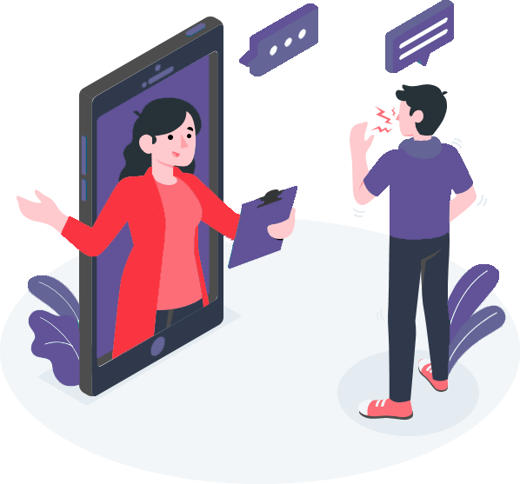
Hisab Kitab Digital Khata
Boston International College
Presentation on
Digital future for your business

Slide 2
OUR TEAM
Subash Khatiwada
Samiksha Rana
Student at Boston International College
Student at Boston International College

Slide 3
TABLE OF CONTENTS
01.
02.
03.
04.
INTRODUCTION
METHODOLOGY
LITERATURE
REVIEW
05.
06.
07.
EPILOGUE
CONCLUSION
RESULT AND DISCUSSION
FUTURE ENHANCEMENTS

Slide 4
01.
INTRODUCTION

Slide 5
BACKGROUND
Hisab Kitab is a mobile application designed to improve the way to manage the business & personal ledgers digitally.
After user login through their phone number they can create, update, and delete the transactions, add payment details and send credit remainder to their customer.

Slide 6

PROBLEM IN EXISTING SYSTEM
Traditional file system:
More chances for human error,
Hard to find past data,
Lengthy maintenance time,
High chance of data redundancy,
Expensive and hard to maintain.

Slide 7
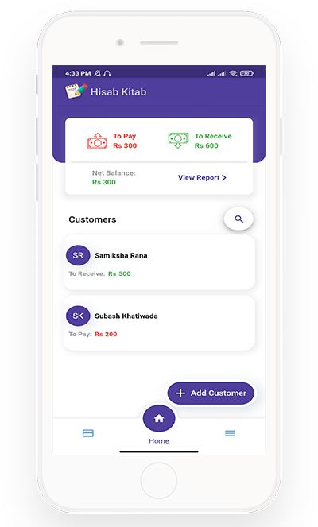
OBJECTIVES
To provide secure transaction between users reducing the chances of error and easier to access past data.
To help small business owners manage their credit accounts and maintain their privacy.
To provide the data security & backup of the user so that they can get their data even if they lost their device.
To help the user get the balance, amount to be taken and amount to be paid at a glance setting the remainder

Slide 8
02.
LITERATURE REVIEW

Slide 9
CASE STUDY
The things we found on our study:
Most of the business sectors still use traditional file system
Misconception of expensive technology
Lack of trust on foreign products for financial transaction
Most people are not able to use because of complex app structure
Most popular in foreign countries like India and USA

Slide 10
03.
METHODOLOGY

Slide 11



TOOLS AND TECHNOLOGY USED
FLUTTER
SQLITE
MYSQL
Flutter framework based on Dart programming language for the frontend or the UI of the system.
SQLite database is used for offline store of datas in tables and relations.
MySQL database is used as the backup of SQLite database using online / offline state.

Slide 12
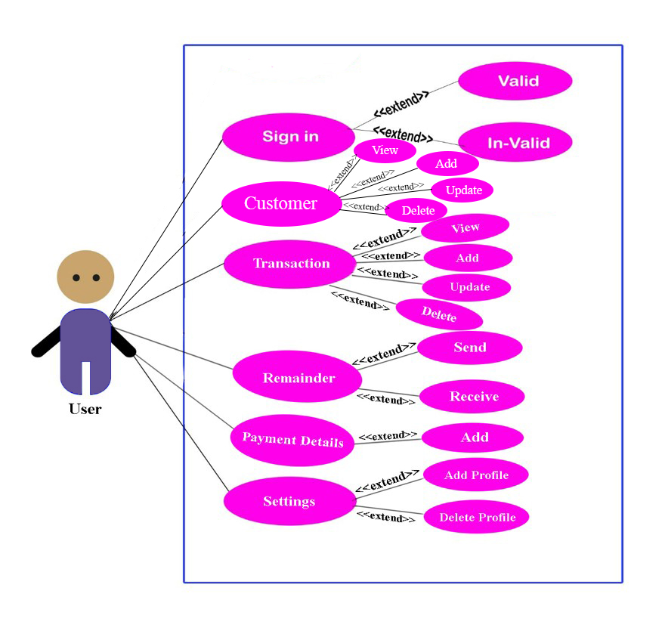
USE CASE DIAGRAM

Slide 13
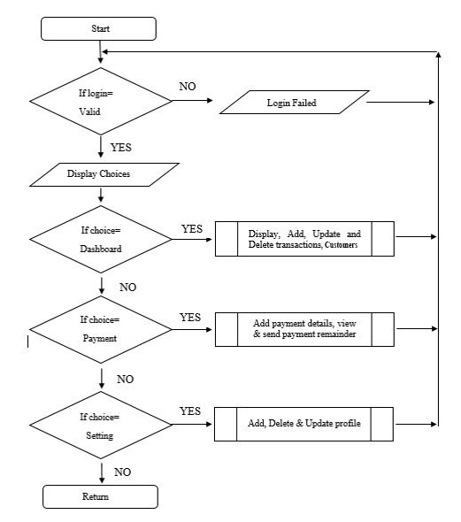
FLOW CHART

Slide 14
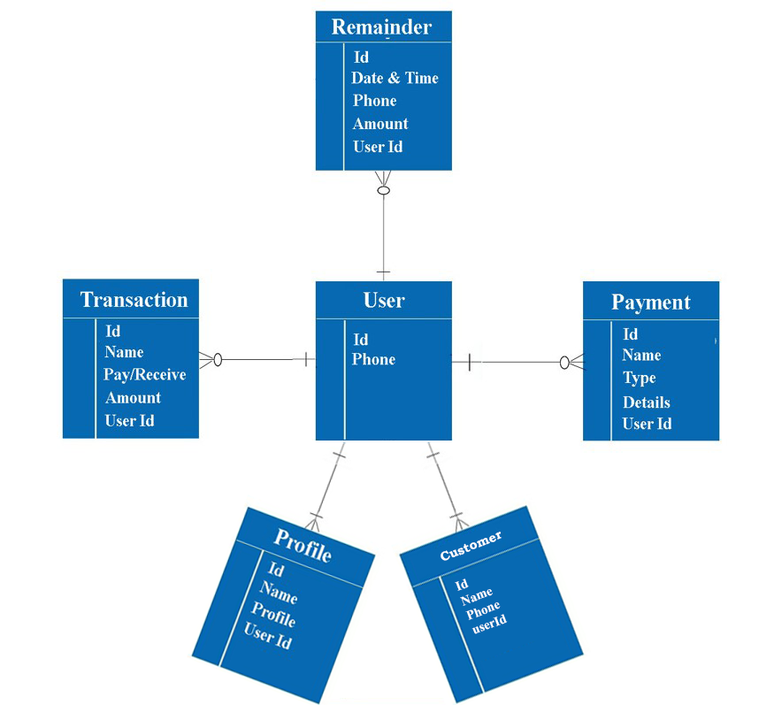
ER DIAGRAM

Slide 15
04.
EPILOGUE

Slide 16
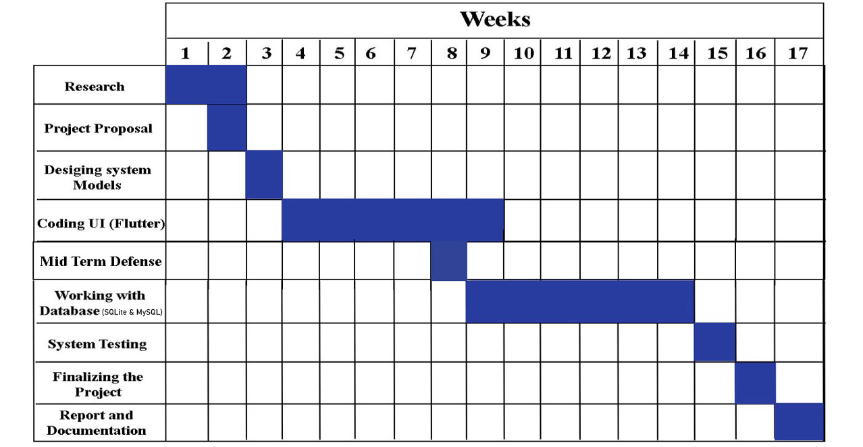
WORK SCHEDULE

Slide 17
05.
RESULT & DISCUSSION

Slide 18
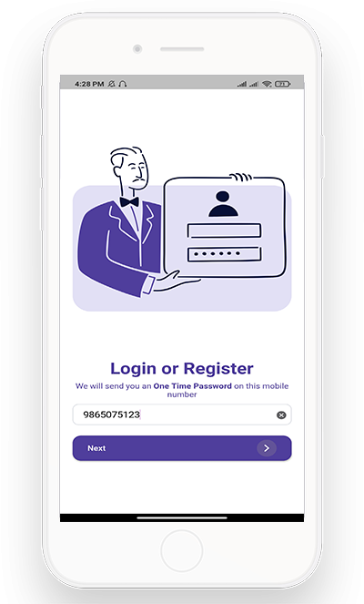
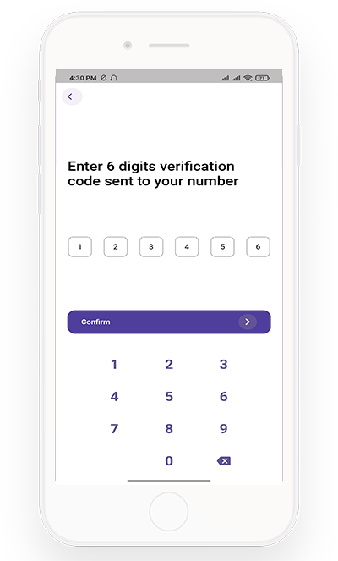
PRODUCT OVERVIEW
Login using Phone Number
OTP Verification

Slide 19
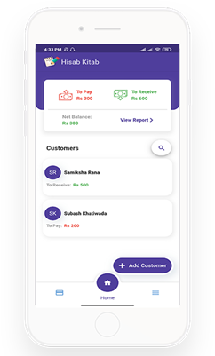
PRODUCT OVERVIEW
TOTAL REPORT
View overall report from all customers
ADD NEW CUSTOMER
Add new customer using customer name and phone number

Slide 20
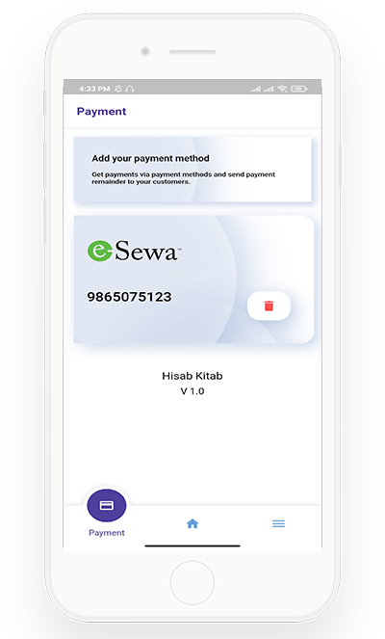
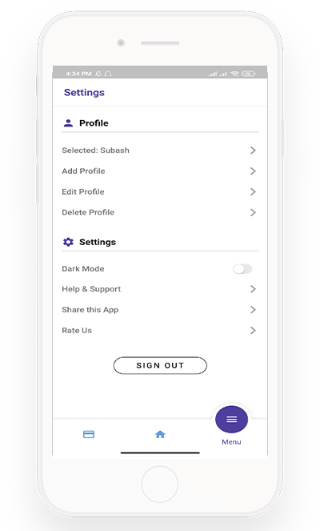
PRODUCT OVERVIEW
PAYMENT PAGE
MENU / SETTINGS PAGE

Slide 21
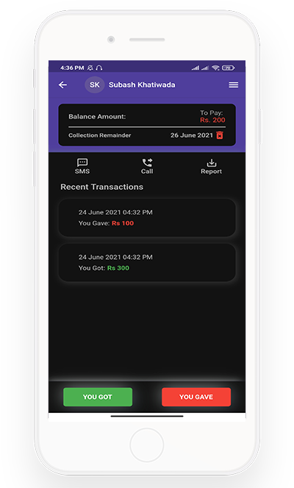
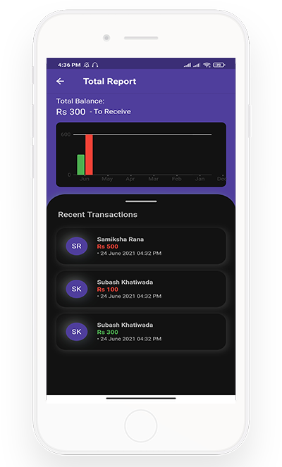
PRODUCT OVERVIEW
SINGLE CUSTOMER PAGE
TOTAL REPORT PAGE

Slide 22
CONCLUSION
Hard to transfer user from traditional file system to digital system
CHALLENGE
Help small business owners manage their credit accounts and maintain their privacy
RESULT
Simplest user interface for the user to use so they can forget their traditional file-keeping system
SOLUTION

Slide 23
FUTURE ENHANCEMENT
Can add expenses tracker and calculate profit and loss
Can add different tools like tax calculator, billing system and more
Will also work on data security, data integration and building more user friendly UI’s.

Slide 24
REFERENCES
Bhatt, P. (2020). Editorial on digitalization in nepal. VOL. 5 NO. 3 (2020): JOURNAL OF ECONOMIC RESEARCH AND STUDIES (ISSN: 2505-1024).
CreditInfo. (2018, February 10). synopsis of khatabook clone. Retrieved from myreadingroom.co.in: http://www.myreadingroom.co.in/notes-and-studymaterial/65-dbms/461-problems-with-file-system.html
Khatabook. (n.d.). Khatabook. Retrieved from Home page: https://khatabook.com/
M Widenius, D. A. (2002). MySQL Reference Manual: Documentation from the Source. Retrieved from https://books.google.com/books?hl=en&lr=&id=9c-pkLaNmqoC&oi=fnd&pg=PR5&dq=mysql+scholar+articles&ots=G2mzcVT0q6&sig=1K6Ca8h2SmL9ahyWs3KKMoz7-_A
Mathur, R. (2020, 04 23). How to develope mobile app like khatabook. Retrieved from Arka Softwares: https://www.arkasoftwares.com/blog/how-to-develop-mobile-app-like-khatabook/
Palser, S. (2015). Mobile Bookkeeping Application for micro entrepreneurs in the Developing World. Western Cape: Sarah Palser.
Peters, D. (2008). Building a GIS: System Architecture Design Strategies for Managers. Retrieved from https://books.google.com.np/books?id=TmylyfCZQ44C
Piyush Bhatnagar, S. R. (2012). System, design and process for strong authentication using bidirectional OTP and out-of-band multichannel authentication. Retrieved from Google Patents: https://patents.google.com/patent/US8763097B2/en
SQLite. (n.d.). What is SQLite. Retrieved from SQLite: https://www.sqlite.org/index.html
Thomas, G. (2019, 12 12). What is Flutter and Why You Should Learn it in 2020. Retrieved from FreeCodeCamp: https://www.freecodecamp.org/news/what-is-flutter-and-why-you-should-learn-it-in-2020/

Slide 25
THANK YOU
Do you have any questions?
Contact: officialhisabkitab@gmail.com

